Slide 1


Slide 2
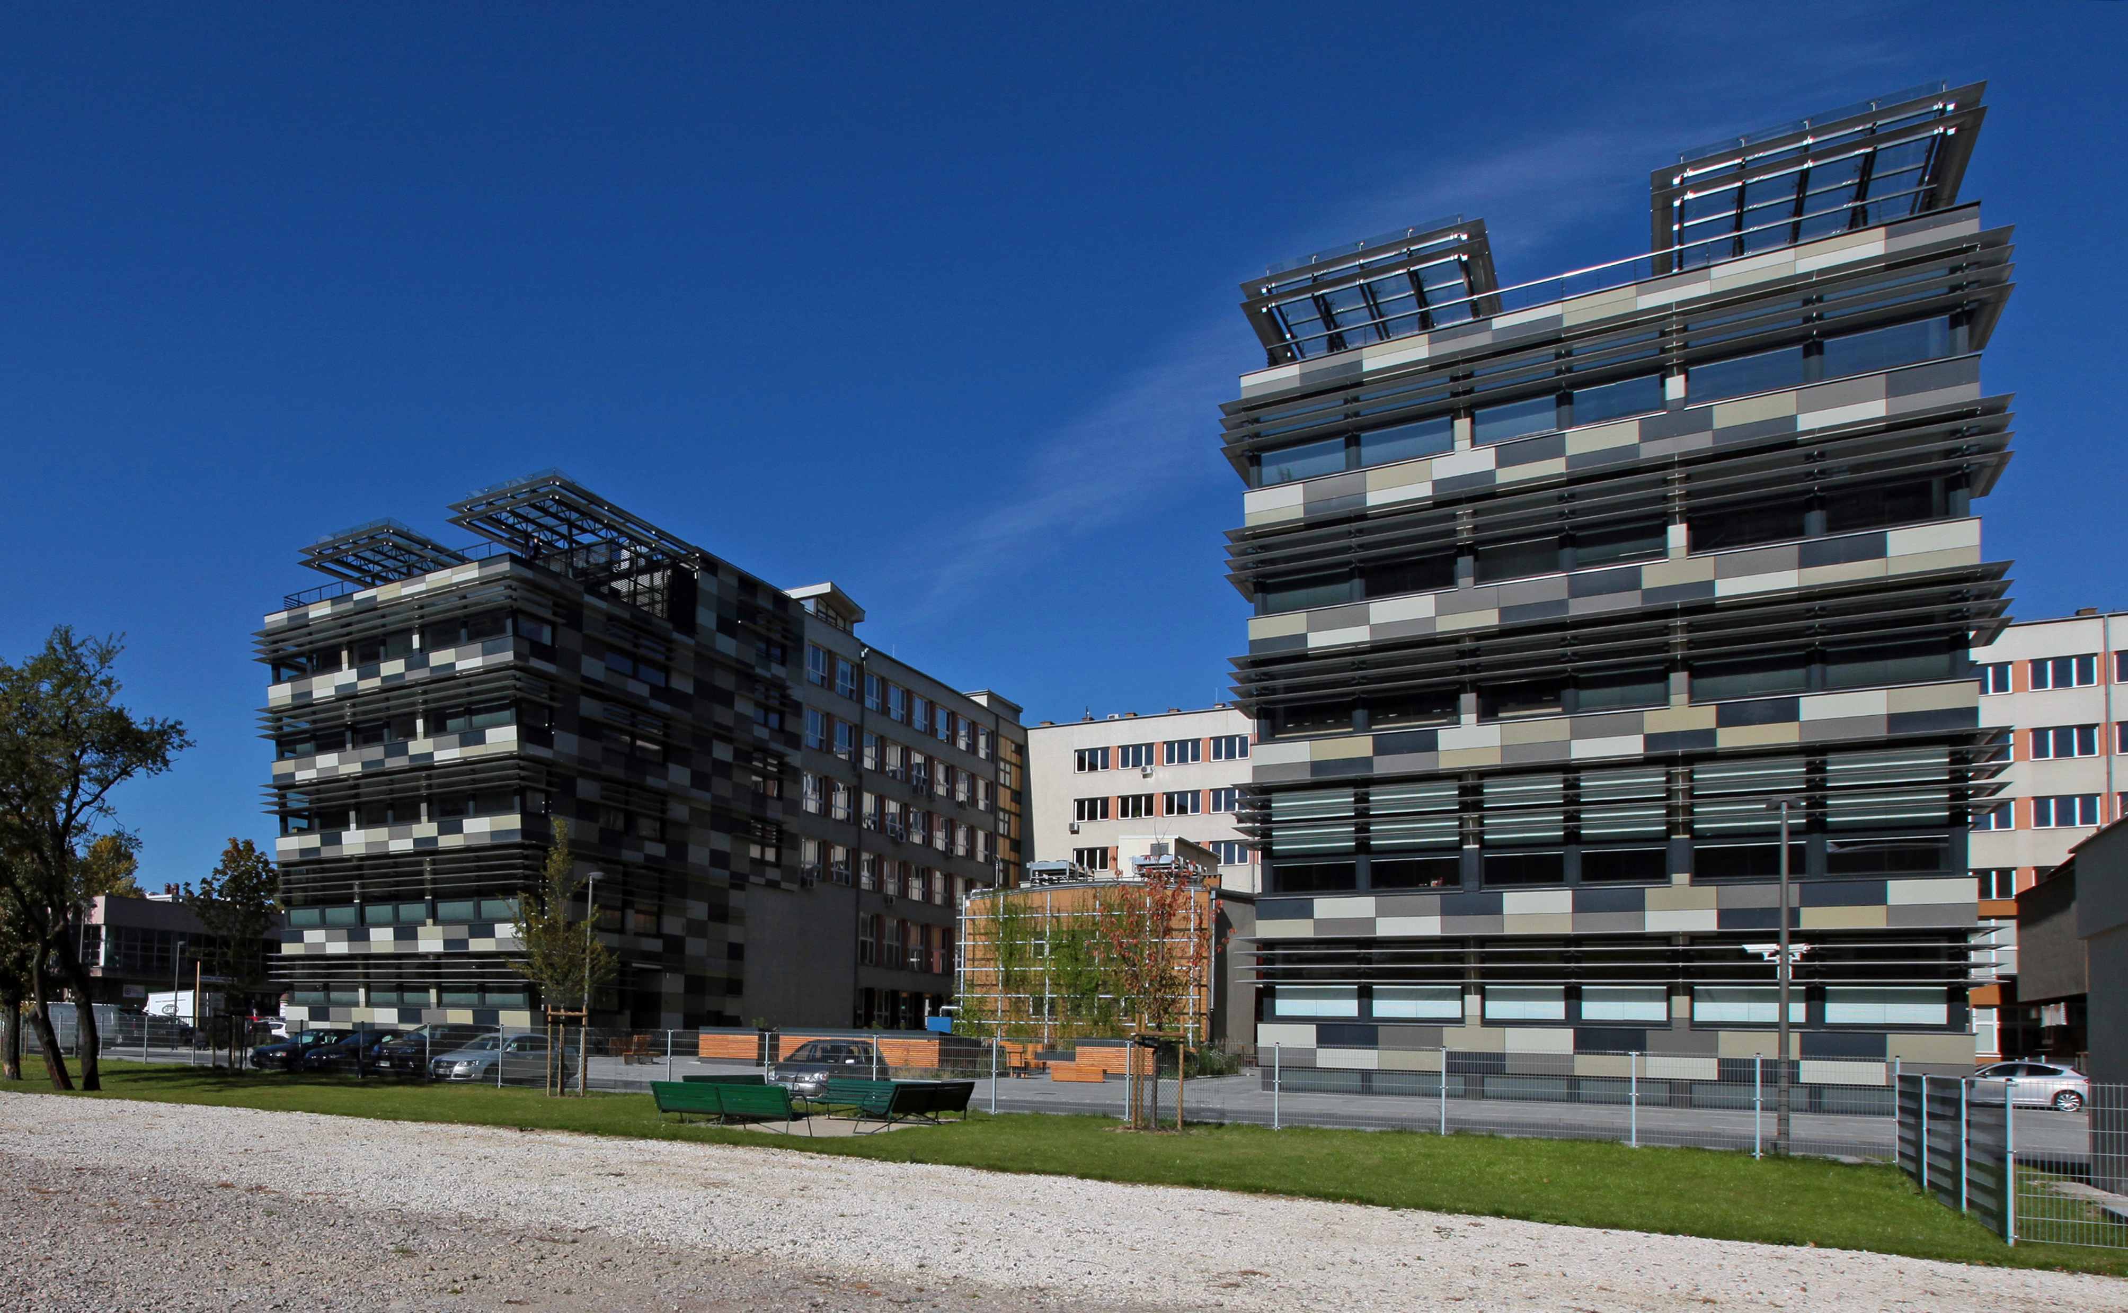

Slide 3
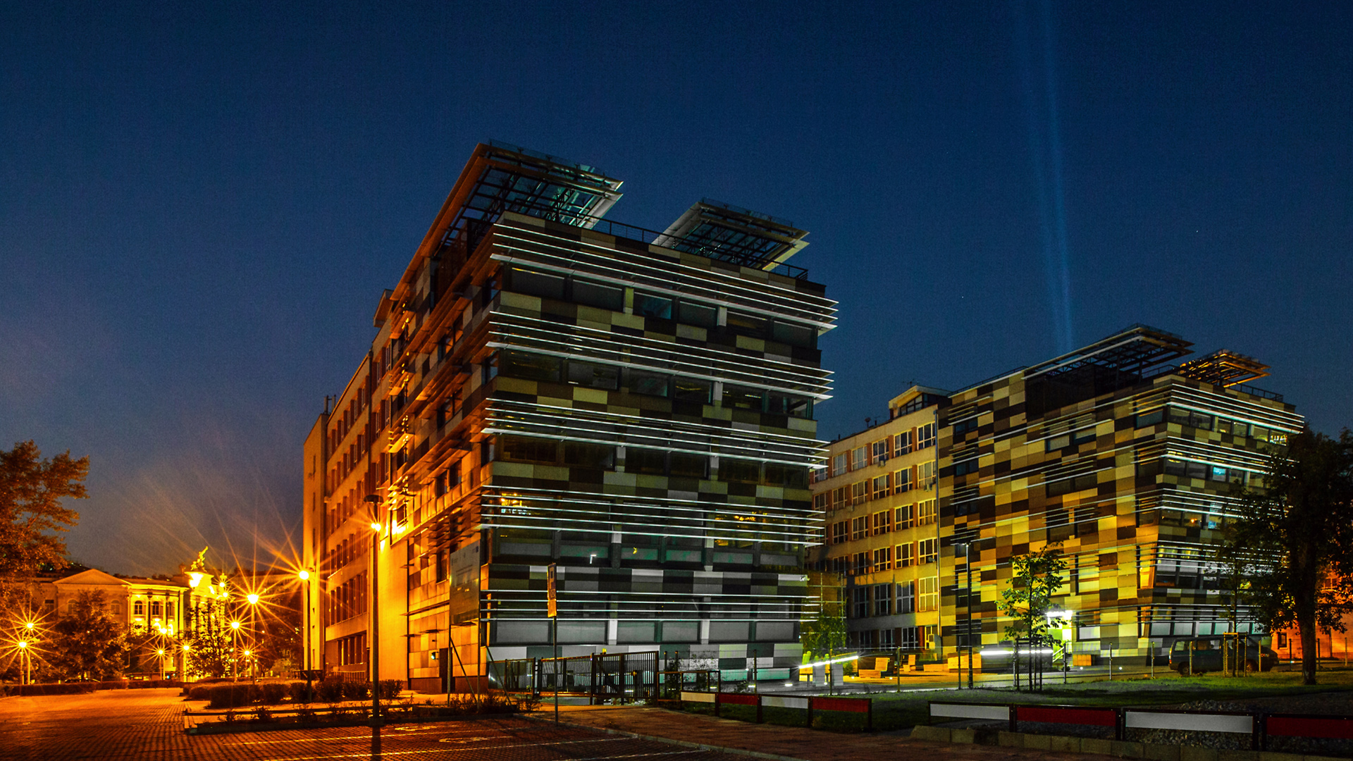

Faculty of Electronics and Information Technology in numbers:
19 faculties and 1 college, where
Over 3000 students and 200 PhD students
Over 300 academic teachers
6 institutes
400 courses
50 laboratories

Slide 4
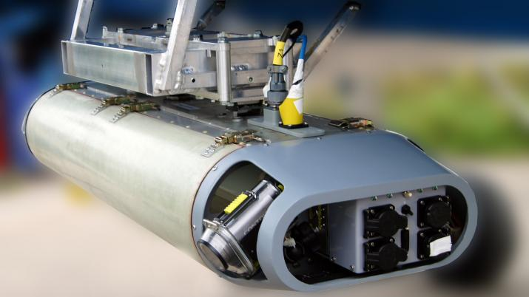
RESEARCH HIGHLIGHTS

Slide 5
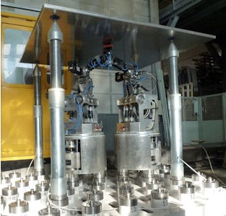
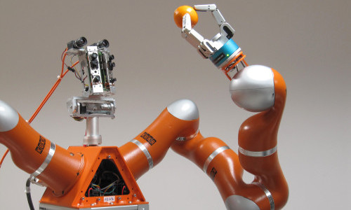
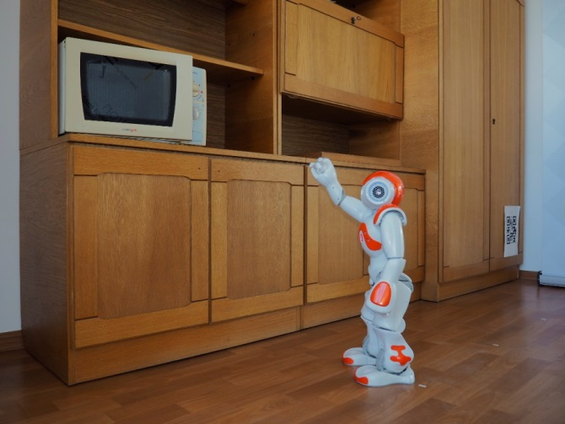
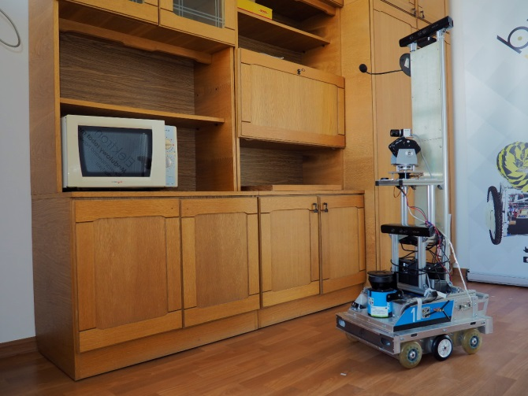
Robot Programming and Pattern Recognition Group
SwarmItFIX – Self- Reconfigurable Intelligent Swarm Fixtures composed
of robots
RobREx - Autonomy in rescue and exploration robots
Methodology of design and implementation of multi-sensory robotic systems for service purposes - Sonata 3
RAPP - Robotic Applications for Delivering Smart User Empowering Applications – cloud robotics

Slide 6
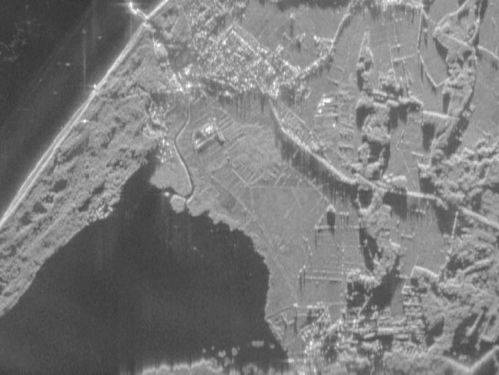
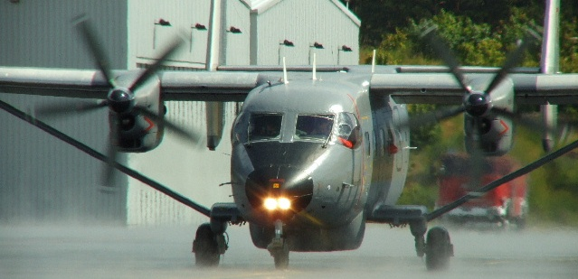
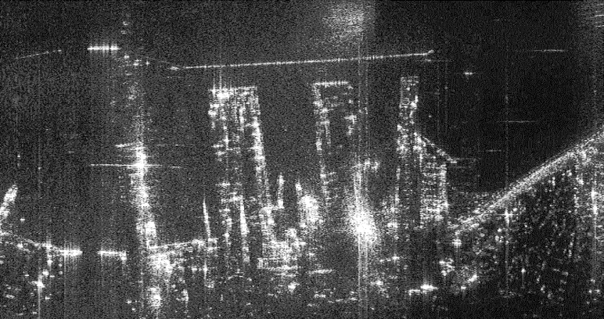
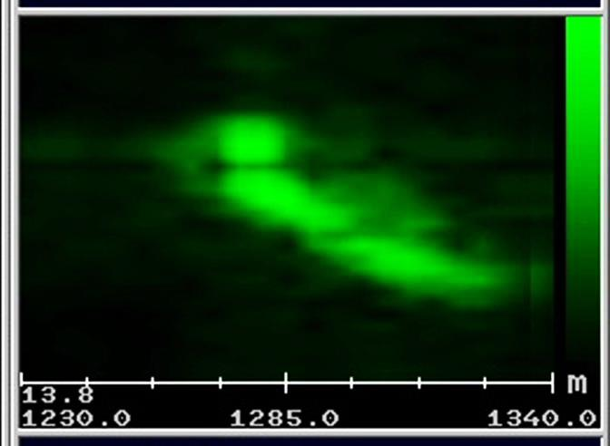

Research group on Radar Techniques
SAR images
Bryza patrol aircraft, X-band radar (in cooperation with Polish industry)
Radar operation modes:
patrol
SAR (Synthetic Aperture Radar) – terrain imaging
ISAR (Inverse SAR) – target imaging
ISAR image

Slide 7
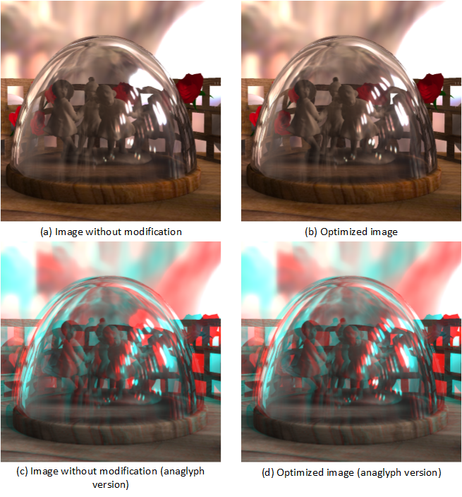
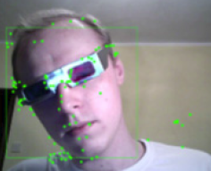

High quality realistic stereoscopic visualization
and simulated holography
Perception based algorithms for analyzing
and controlling disparity in high-quality realistic stereoscopic visualization
(partially in cooperation with Max-Planck Institute and MIT)

Slide 8

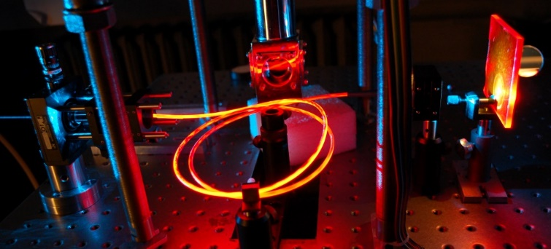
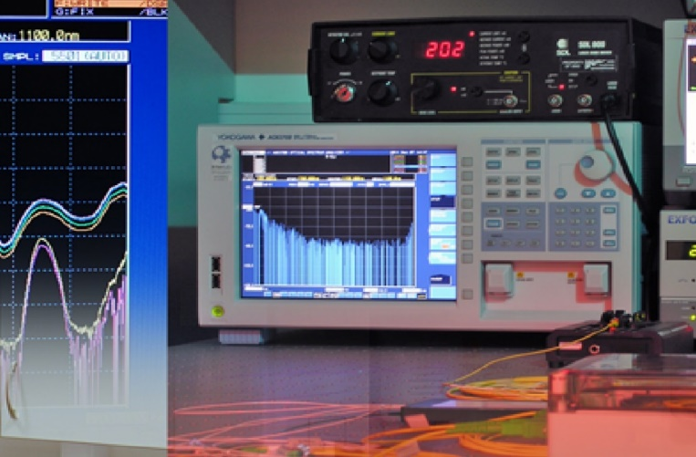
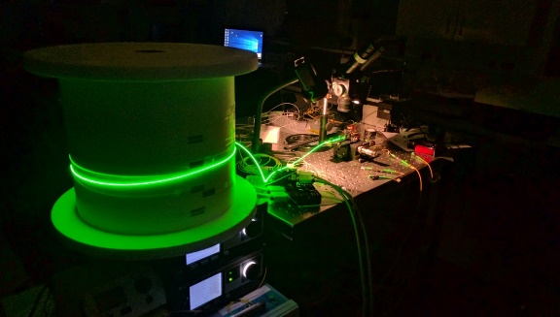
Fiber optic photonics
Short-wavelength fiber lasers (incl. up-conversion lasers)
NIR fiber lasers and amplifiers (incl. turn-key systems)

